Slide 1
22CS015
Telco Customer Churn Prediction
Team Members:
Nishtha(2210991992),Prachi(2210992053),
Pragati(2210992056),Priya(2210992096)
Supervised By: Mr. Anoop Dobhal
Department of Computer Science and Engineering
Chitkara University, Punjab

Slide 2
INTRODUCTION
Telco Customer Churn Prediction
Customer churn is defined as when customers or subscribers discontinue doing business with a firm or service.
Individualized customer retention is tough because most firms have a large number of customers and can't afford to devote much time to each of them. The costs would be too great, outweighing the additional revenue. However, if a corporation could forecast which customers are likely to leave ahead of time, it could focus customer retention efforts only on these "high risk" clients. The ultimate goal is to expand its coverage area and retrieve more customers loyalty. The core to succeed in this market lies in the customer itself.
To detect early signs of potential churn, one must first develop a holistic view of the customers and their interactions across numerous channels, including store/branch visits, product purchase histories, customer service calls, Web-based transactions, and social media interactions, to mention a few.
As a result, by addressing churn, these businesses may not only preserve their market position, but also grow and thrive. More customers they have in their network, the lower the cost of initiation and the larger the profit. As a result, the company's key focus for success is reducing client attrition and implementing effective retention strategy.

Slide 3
Telco Customer Churn Prediction
ABSTRACT
This study examines customer churn within a telecommunications company, utilizing a dataset that comprises several attributes of customer interaction and service subscription. The attributes include basic demographic information like gender and senior citizen status, as well as more detailed service-related features such as tenure, types of services subscribed (e.g., phone, multiple lines, internet, security), billing methods, and charges. A unique identifier for each customer allows for individual tracking over time. The primary goal is to identify predictive factors of churn, thereby enabling targeted customer retention strategies.
By analyzing these features, we aim to develop a predictive model using machine learning techniques to forecast the likelihood of churn. This model will assist the company in prioritizing retention efforts towards high-risk customers, potentially reducing churn rates and increasing overall customer loyalty. The findings of this study are expected to provide actionable insights that can be utilized not only to mitigate customer attrition but also to enhance the customer experience and optimize service offerings.

Slide 4
Telco Customer Churn Prediction
KEY FEATURES
SMOTE: Generally, the use of SMOTE significantly improves the accuracy of all models, highlighting the importance of addressing class imbalance in churn prediction datasets.
Regularization (Lasso/Ridge): Useful in reducing overfitting and improving model generalization, particularly for logistic regression.
Ensemble Methods (Random Forest, XGBoost): These models naturally excel by aggregating results from multiple models, reducing variance and bias, and perform exceptionally well when combined with SMOTE.
Random Forest using SMOTE: Accuracy = 0.969
Key Features: The highest accuracy among the models when using SMOTE, indicating exceptional handling of class imbalance and inherent model variance.
XGBoost using SMOTE: Accuracy = 0.961
Key Features: Shows substantial improvement with balanced classes. Benefits from both SMOTE and the model’s built-in regularization to reduce overfitting and improve prediction accuracy.

Slide 5
Telco Customer Churn Prediction
KEY FEATURES OF FLASK MODEL
1. Integration with Pre-trained Machine Learning Models
Model and Scaler Loading: The application loads a pre-trained Random Forest model and a scaler from a pickle file. This is efficient for deploying models as it separates model training from prediction, ensuring that the web application only focuses on serving predictions.
Web Interface Handling
Flask Routes:
Home Route(‘/’): This serves the landing page of the application, likely providing users with a form to input their data.
Submit Route(‘/submit’): Handles the POST requests from the form, processes the user input, and returns the prediction result. This is the core of the interaction between the user and the model.
Form Data Processing:The application retrieves data directly from the form inputs, demonstrating how Flask can handle user input seamlessly for real-time predictions.
3. Data Pre-processing and Feature Engineering within the Application
Categorical Encoding: The application maps categorical inputs to numeric values, mirroring the pre-processing done during model training. This is crucial for maintaining consistency in how the model interprets the input features.
Data Scaling: Utilizing a scaler ,the application standardizes the input features before feeding them to the model. This ensures that the model receives
data in the same format as during its training phase.

Slide 6
Telco Customer Churn Prediction
4. Predictive Analysis Execution
Prediction: After processing and scaling the data, the application uses the loaded Random Forest model to predict whether the customer is likely to churn based on the input features.
Result Interpretation: Converts the numerical prediction into a user-friendly message that indicates whether the customer is likely to churn, enhancing the user experience by providing easily understandable output.
5. Error Handling
Exception Management: The application includes a try-except block around the prediction logic, which is essential for catching and handling errors that could occur during the prediction process (e.g., wrong data types, missing values). This improves the robustness of the application by preventing it from crashing and instead providing a meaningful error message.
6. Deployment and Accessibility
Running on Flask Development Server: The app is configured to run on a local development server with debugging enabled, which is good for development and testing but should be adapted for production using a more robust server like WSGI servers.

Slide 7
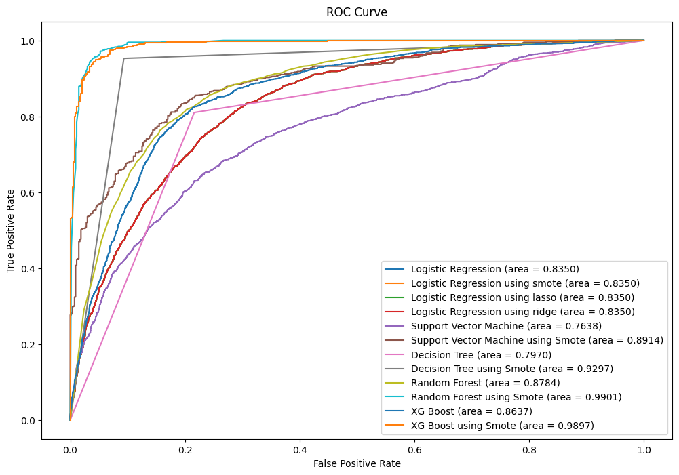
Telco Customer Churn Prediction
ROC CURVE

Slide 8
Telco Customer Churn Prediction
The Receiver Operating Characteristic (ROC) curve is a graphical plot that illustrates the diagnostic ability of a binary classifier system as its discrimination threshold is varied. It is created by plotting the True Positive Rate (TPR) against the False Positive Rate (FPR) at various threshold settings:
Area Under the Curve (AUC): The AUC value is a measure of the model's ability to discriminate between the classes. An AUC close to 1.0 suggests a model with excellent prediction accuracy, while an AUC near 0.5 indicates no discriminative power, equivalent to random guessing.
Model Interpretation:
A higher AUC value for the Random Forest model, especially with SMOTE, implies that it effectively distinguishes between customers who will churn and those who will not. The ROC curve for this model would likely show a steep rise towards the top-left corner of the plot, indicating high sensitivity (high TPR) and specificity (low FPR).
The ROC curve provides insights beyond simple accuracy by showing how well the model can adjust its classification threshold to balance the TPR and FPR. This is particularly useful in business contexts where the cost of a false positive (e.g., unnecessarily targeting a customer for retention efforts) might be weighed against the cost of a false negative (e.g., missing a customer at high risk of churn).
Practical Applications
For telecom companies, using a Random Forest model with such high accuracy and a strong AUC value means they can more confidently implement targeted intervention strategies. By adjusting the model's threshold based on the ROC curve analysis, the company can optimize its churn prevention strategies to either focus on capturing as many true positives as possible (at the risk of some false positives) or to minimize false alarms, depending on their cost implications and customer management priorities.
Overall, the Random Forest model, particularly when enhanced with SMOTE, proves to be a very effective tool for predicting customer churn, helping telecom companies save costs on retention campaigns and better allocate their resources.

Slide 9
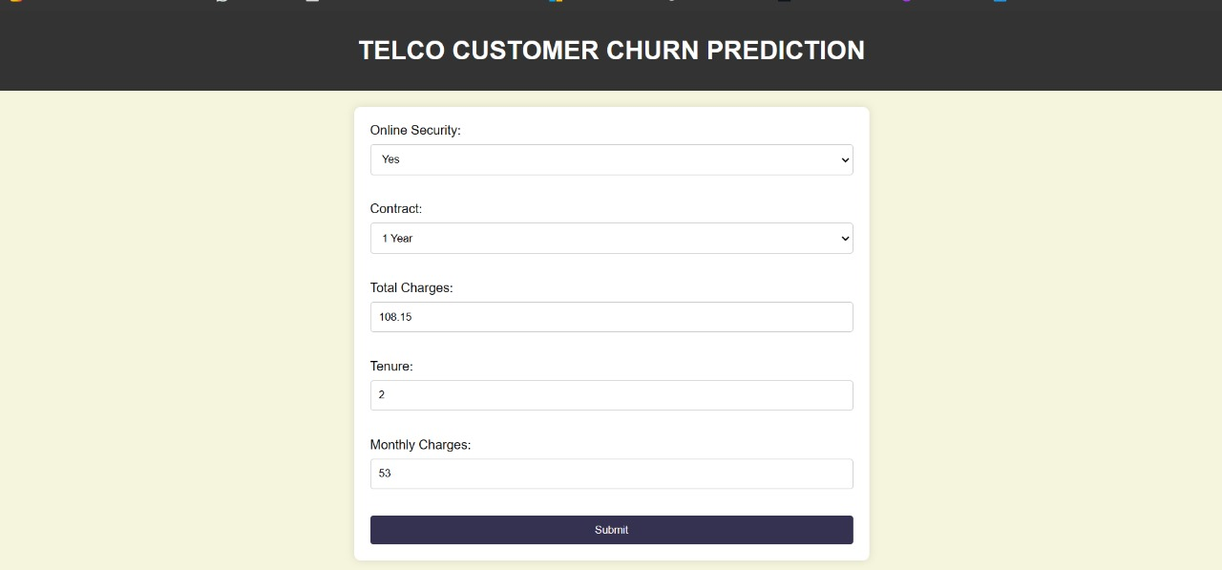
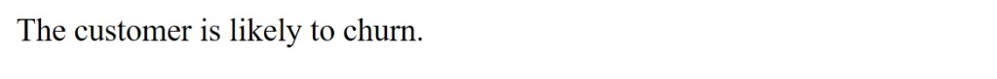
Telco Customer Churn Prediction
DASHBOARD

Slide 10
Telco Customer Churn Prediction
Overview of the Flask
Flask is a lightweight and flexible Python web framework that provides tools, libraries, and technologies to build a web application. It is particularly well-suited for smaller applications and microservices due to its simplicity and minimalistic approach. This makes Flask an ideal choice for deploying machine learning models where the focus is on functionality rather than complex web infrastructure.
Functionality:
Model Deployment: Your application integrates a pre-trained Random Forest model loaded from a pickle file, which includes both the model and the scaler. This setup ensures that the predictive model can be directly utilized to assess new data input via the web interface.
Web Forms for Data Input: The application features a simple user interface rendered by ‘index.html’, where users can input relevant data about telecom customers. This data includes attributes such as Online Security status, Contract type, Total Charges, Tenure, and Monthly Charges.
Data Processing: Upon submission, the web form data is captured and processed. Categorical data is converted into a numerical format that matches the training conditions of the model, ensuring accuracy in predictions. Continuous data inputs are scaled using the pre-loaded scaler.

Slide 11
Telco Customer Churn Prediction
Prediction and Output: The processed data is fed into the Random Forest model, which predicts customer churn. The prediction result is then presented to the user as a straightforward message indicating the likelihood of churn.
Use of the Dashboard
The dashboard serves as a decision-support tool, helping stakeholders in the telecom industry to identify customers at high risk of churn. This enables targeted interventions, such as personalized offers and communication, aimed at improving customer retention rates. Furthermore, by making the analytics accessible through a simple web interface, it democratizes the use of advanced data-driven insights across different levels of the organization.
Overall, your Flask application effectively bridges the gap between complex machine learning algorithms and practical business applications. It encapsulates the model within a user-friendly dashboard, providing a valuable tool for strategic decision-making in customer retention.

Slide 12
Telco Customer Churn Prediction
CONCLUSION
Model Performance and Accuracy
Several models were evaluated, with the Random Forest model augmented by SMOTE (Synthetic Minority Over-sampling Technique) showing particularly high accuracy. The application of SMOTE significantly improved the model's ability to handle imbalanced data, leading to more reliable predictions:
Random Forest with SMOTE: Improved accuracy dramatically to 96.9%, highlighting the effectiveness of addressing class imbalance in enhancing model performance.
The use of ROC curves and AUC metrics provided clear insights into the models' discriminative abilities, affirming that the enhanced Random Forest model is highly capable of distinguishing between customers who will churn and those who will not.
Dashboard Usability and Business Application
The Flask-based dashboard transformed the predictive models from abstract algorithms into practical tools for business users. By providing a user-friendly interface, the dashboard allows customer service representatives and managers to input customer data and receive churn predictions in real-time. This immediacy supports swift and informed decision-making that is crucial for effective customer retention strategies.

Slide 13
Telco Customer Churn Prediction
REFERENCE
https://www.kaggle.com/code/bhartiprasad17/customer-churn-prediction
https://www.javatpoint.com/machine-learning-models
https://www.geeksforgeeks.org/random-forest-algorithm-in-machine-learning/
https://www.analyticsvidhya.com/blog/2020/04/how-to-deploy-machine-learning-model-flask/
https://www.educative.io/answers/how-to-save-a-machine-learning-model-using-pythons-pickle-module

